Slide 1
Understanding Health Equity for Mothers and children
Mrs. Brittney G. Mosley
Mississippi State Department of Health

Slide 2
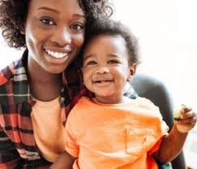
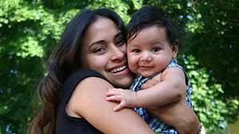
Images: www.cdc.gov; www.Oregon.gov

Slide 3
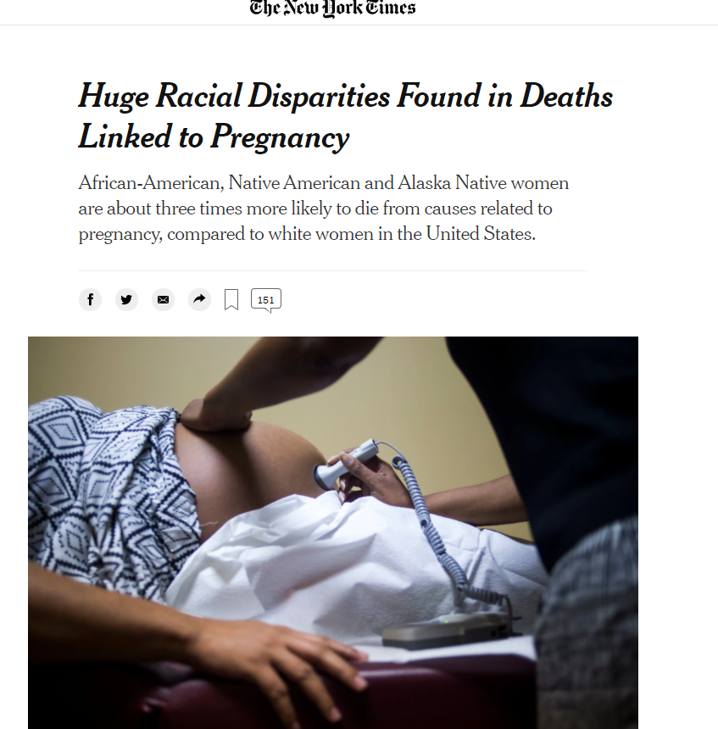
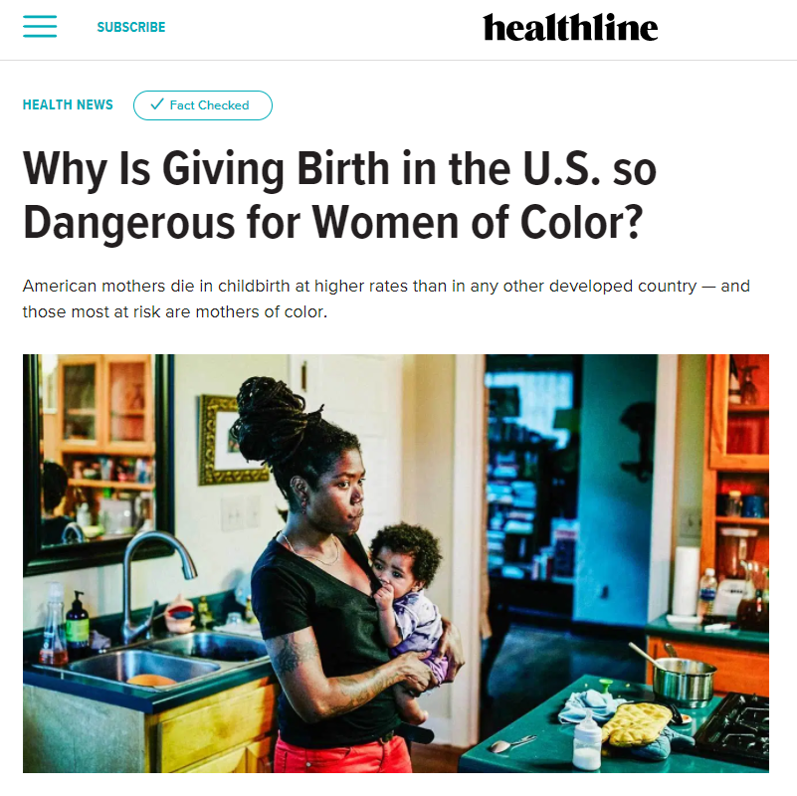
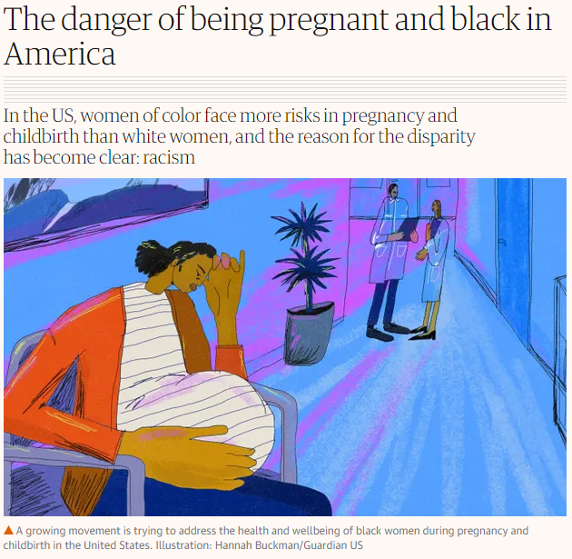

Slide 4
What affects birth outcomes?

Slide 5
Risk Factors and Social Determinants of Health
Social/economic conditions
Teen pregnancy
Mississippi-medically underserved state
Chronic Health Conditions prior, during, and after pregnancy
Mental Health
COVID-19
Maternal Mortality
Breastfeeding
Weathering
Racial disparities (racism is a threat to public health-AMA)

Slide 6
Calling All Sectors-State Agencies Joined for Health
Health equity project centered around mothers and children
Funded by the PEW Charitable Trust and Robert Wood Johnson Foundation
Objective-to improve birth outcomes in African American women in childbearing age by
Address racial disparities in preterm birth, low birthweight, and infant and maternal mortality
Increasing awareness of state-level and community-based maternal and child health resources that are culturally and linguistically appropriate

Slide 7
What can we do?
Understand that health equity includes everyone in and beyond the healthcare setting (SDOH)
Build relationships within agencies (internal and external) and strong collaboration of referrals
Provide training in implicit bias to healthcare professionals and community organizations
Create policies, systems, and environmental changes (PSE) in schools, workplaces, churches, etc. that supports families that embeds health equity
Form a “safe haven” for mothers with resources and tools

Slide 8
References
Bryant, Allison S., MD, Worjoloh, Ayaba, MD, MPH, Caughey, Aaron B., MD, PhD, and Washington, A. Eugene, MD, MSc (2010). Racial/Ethnic Disparities in Obstetrical Outcomes and Care: Prevalence and Determinants. Am J Obstet Gynelo., April; 202 (4): 335-343.
Campbell, Leah (2018, Sept 14.) Why Is Giving Birth in the U.S. so Dangerous for Women of Color. Healthline, pp.1-3.
Charlene Collier, M. M. (2019). Mississippi Maternal Mortality Report 2013-2016. Jackson.
Collier, C., Pepper, S., Walker, T., Kurmana, S., Qobadi, M., Vargas, R., … Zhang, L. (2018). Infant Mortality Report. Jackson, MS: Mississippi State Department of Health.
Grummer-Strawn LM, S. K. (2009). Progress in protecting, promoting, and supporting breastfeeding: 1984-2009. Breastfeed Med, S31-S39.
Mississippi State Department of Health, Centers for Disease Control and Prevention. (2016). Pregnancy Risk Assessment Monitoring System (PRAMS) [Data file]. Jackson, MS: Mississippi State Department of Health.
Mississippi State Department of Health. (n,d.). Mississippi Statistically Automated Health Resources System (MSTAHRS). Retrieved from http://mstahrs.msdh.ms.gov/
Mississippi State Department of Health, Centers for Disease Control and Prevention. (2020). Coronavirus Disease 2019 (COVID-19) [Data file]. Jackson, MS: Mississippi State Department of Health. Retrieved from http://msdh.ms.gov/

Slide 9
References
Narang, Kavita, MD, Enninga, Elizabeth Ann L., PhD, . Gunaratne, Madugodaralalage D.S.K MBBS, Ibirogba, Eniola R., MBBS, . Trad, Ayssa Teles A, MD, Elrefaei, Amro, MBBCh, Theiler, Regan N. MD, PhD, Ruano, Rodrigo MD, PhD, Szymanski, Linda M., MD, PhD, Chakraborty, Rana, MD, DPhil, and Garovic, Vesna D. MD, PhD. SARS-CoV-2 Infection and COVID-19 During Pregnancy: A Multidisciplinary Review. Mayo Clin Proc. 2020 Aug; 95(8): 1750–1765.
National Medical Association. COVID-19 underscores wealth and health disparities in the African American community. Available at: https://www.nmanet.org/news/500673/COVID19-Underscores-Wealth-and-Health-Disparities-in-the-AfricanAmerican-Community.htm; 2020. Accessed August 29, 2020.
O’Hara MW. Postpartum depression: What we know. J Clin Psychol 2009;65:1258–1269. 47.
Pediatrics, A. A. (2012). Policy statement: breastfeeding and the use of human milk. Pediatrics, 129 (3). Retrieved from www.pediatrics.org/cgi/content/full/129/3/e827
Perez, Miriam Zoila (2019, May 2.) The Danger of Being Pregnant and Black in America. The Guardian, pp.1-3.
Rabin, Roni Caryn (2019, May 7.) Huge Racial Disparities Found in Deaths Linked to Pregnancy. New York Times, pp.1-2.
Shah, Monica, BSc, Sachdeva, Muskaan, BHSc, Dodiuk-Gad, Roni P, MD. COVID-19 and Racial Disparities. Journal of the American Academy of Dermatology. 2020 April. https://doi.org/10.1016/j.jaad.2020.04.046
Xu JQ, Murphy SL, Kochanek KD, Bastian B, Arias E. (2018). Deaths: Final data for 2016. National Vital Statistics Reports; (5th ed., Vol. 67). Hyattsville, MD: National Center for Health Statistics.
Yonkers KA, Wisner KL, Stewart DE, et al. The management of depression during pregnancy: A report from the American Psychiatric Association and the American College of Obstetricians and Gynecologists. Gen Hosp Psychiatry 2009; 31:403–413.

